Slide 1

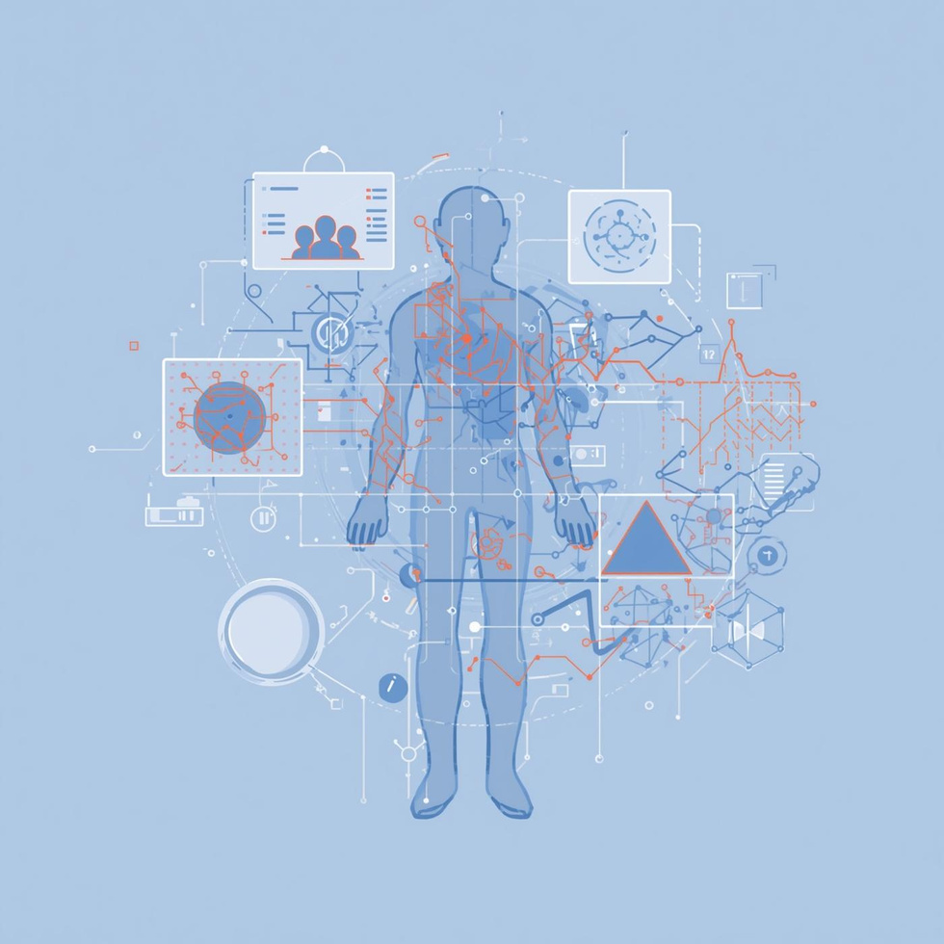
SKIN DISEASE DETECTION SYSTEM

Slide 2
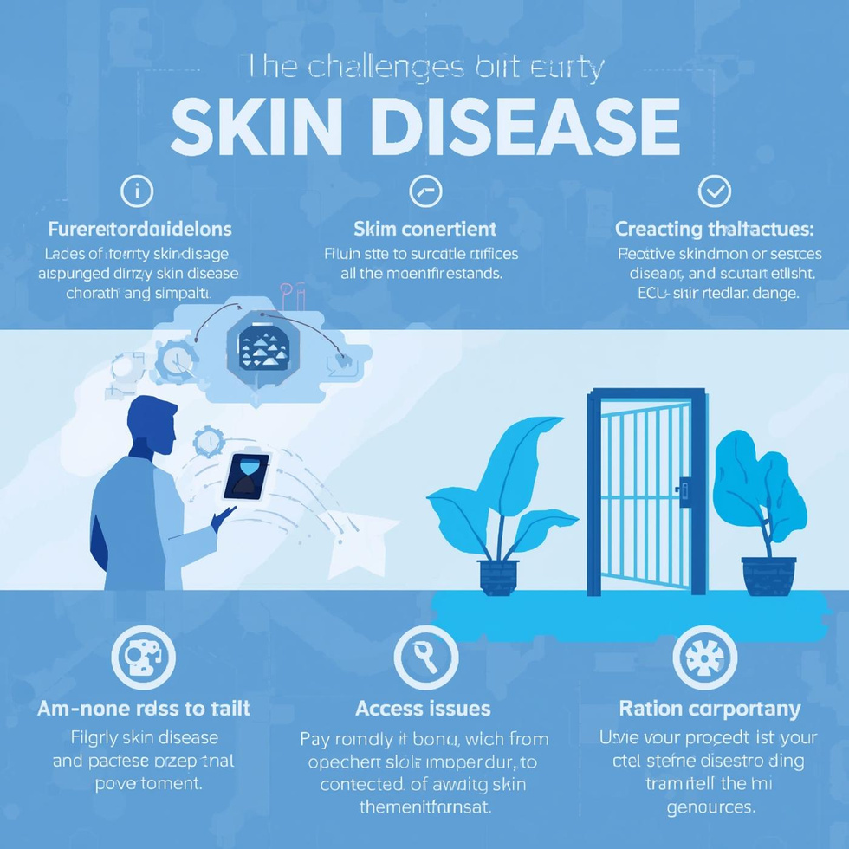
Problem Statement
Early detection of skin diseases is critical for effective treatment and recovery. However, manual diagnosis often leads to delays and inaccuracies due to limited access to specialists and misinterpretation of symptoms. This lack of automation can result in missed opportunities for timely intervention. Therefore, implementing an AI-based solution is essential to enhance diagnostic accuracy and accessibility for patients, improving overall health outcomes.

Slide 3
Objectives
Accurate Classification
Similar Image Retrieval
Chat Support
The system aims for precise identification of skin diseases using advanced AI algorithms and MobileNetV2 embeddings.
Users can retrieve similar cases through efficient matching algorithms that enhance diagnostic support and accuracy.
An integrated chat feature provides real-time assistance and suggestions based on user queries and uploaded images.

Slide 4
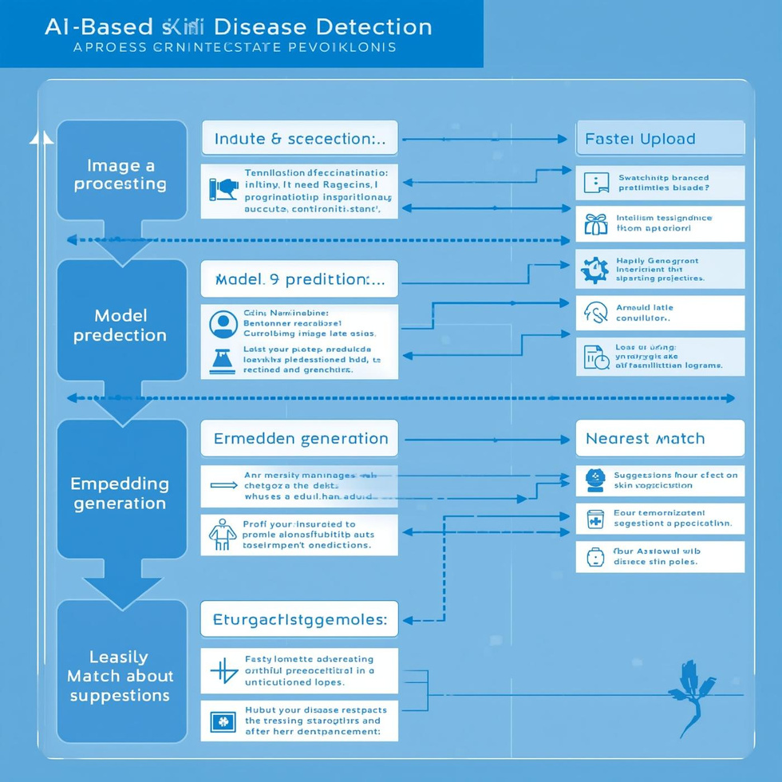
System Flow
This section outlines the workflow of the AI-based skin disease detection system. It begins with image upload, followed by preprocessing to enhance quality. The model then predicts the disease, generating embeddings for similarity matching. Finally, the system retrieves the nearest match and provides tailored suggestions, creating an efficient and user-friendly experience for accurate diagnosis and support.

Slide 5
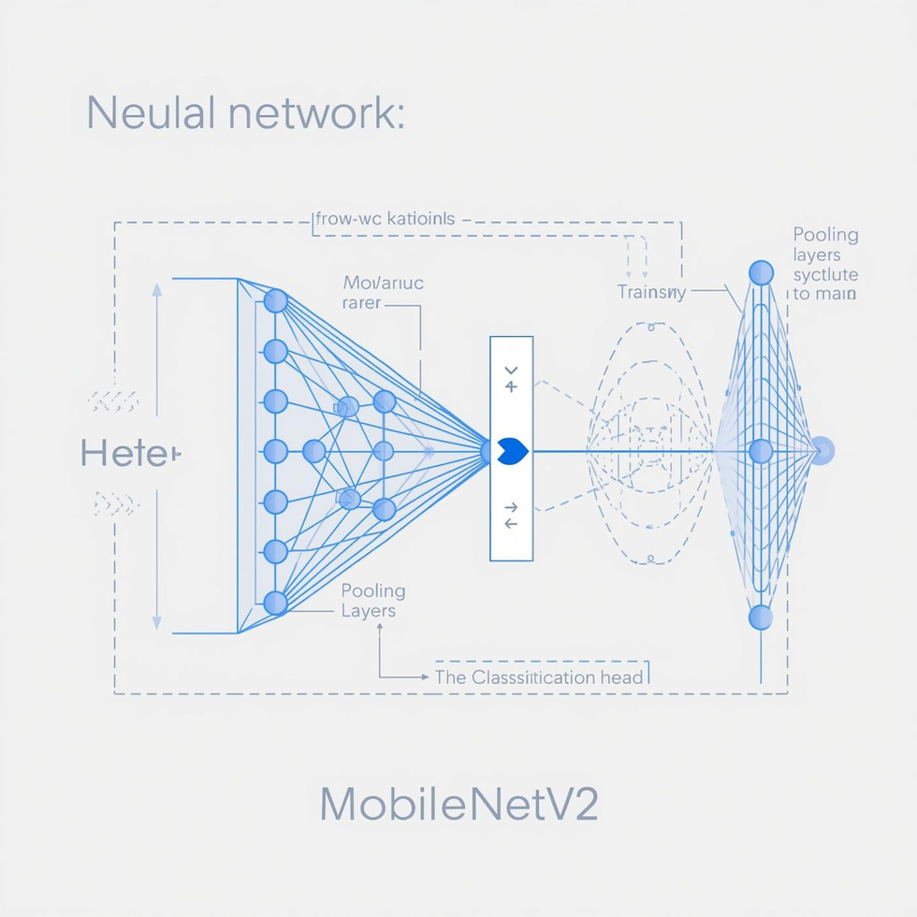
Model Architecture
MobileNetV2 is a light and efficient model designed for mobile and edge devices. It employs depthwise separable convolutions, significantly reducing the number of parameters while maintaining accuracy. This architecture enables effective embedding extraction, which is essential for classifying skin diseases. By leveraging transfer learning, MobileNetV2 allows for rapid adaptation to new datasets, improving overall model performance in real-world applications.

Slide 6
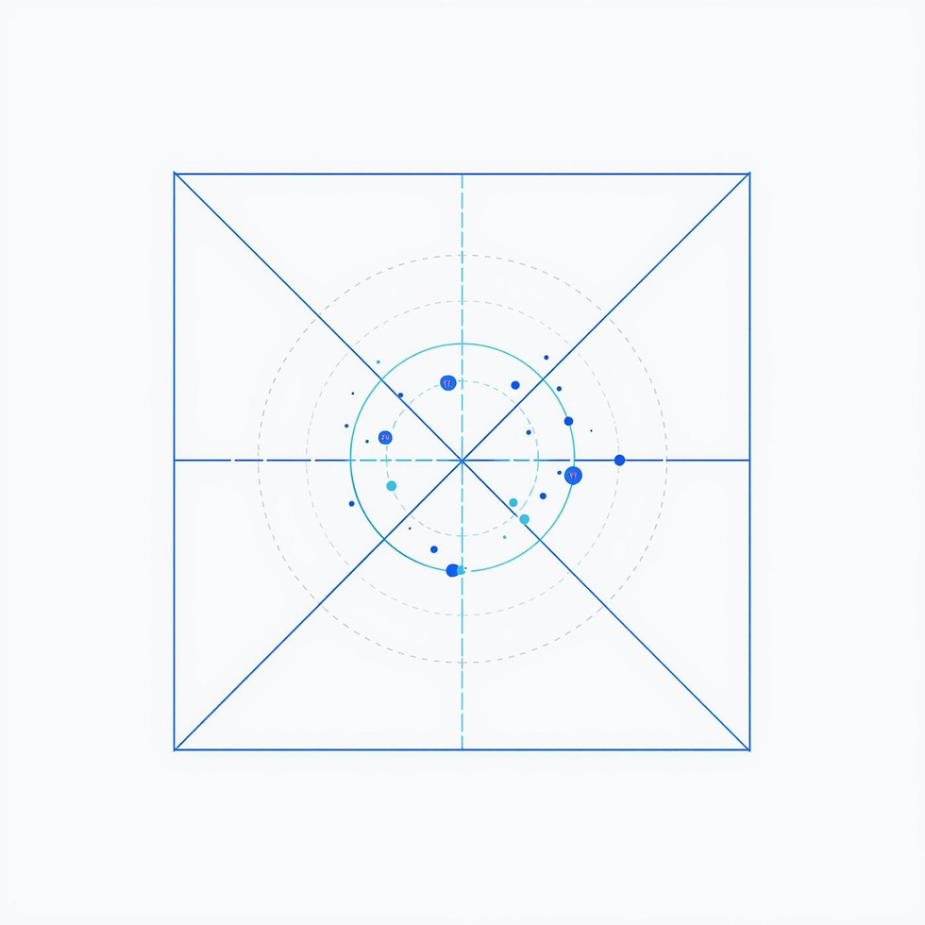
Similarity Matching
The embeddings and similarity matching system utilizes L2-normalized vectors to represent images within a high-dimensional space. By employing cosine similarity, the system efficiently retrieves the nearest matches based on user-uploaded images. This approach enhances accuracy in classification and allows for the quick identification of similar cases, significantly improving the user experience in skin disease detection.

Slide 7

Flask Web App
The Flask web application serves as the backbone of our AI skin disease detection system. It facilitates seamless interaction through various backend routes, including /predict for image classification, /chat for user inquiries, and /matched for displaying similar cases. This setup ensures efficient communication between the user interface and the AI models, enhancing overall user experience and accessibility.

Slide 8

Chat Assistant
Suggestions
TF-IDF Search
Example Thumbnails
The system provides label-aware suggestions based on user input, enhancing personalized assistance for skin conditions.
Utilizing TF-IDF search, the assistant retrieves relevant information quickly, improving the user experience significantly.
Users receive visual references through example thumbnails, allowing better understanding and identification of similar cases.

Slide 9
Technologies Used for Skin Disease Detection
Key components of our tech stack
Python for backend development
Flask for web application framework
TensorFlow for machine learning models
MobileNetV2 for image classification
HTML/CSS/JS for frontend interface

Slide 10
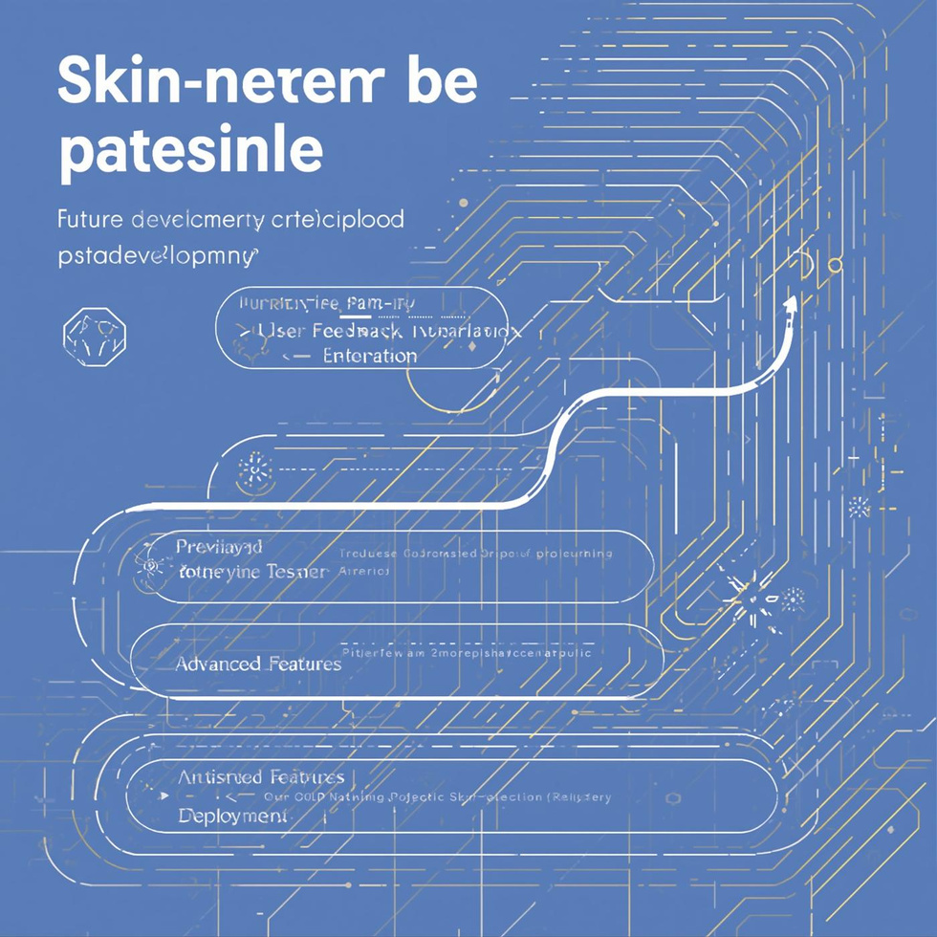
Future Roadmap
The outcomes of our AI-based skin disease detection project showcase a successful prototype capable of real-time predictions. Future enhancements will focus on improving user experience, integrating more advanced features, and gathering user feedback to ensure the system meets the needs of both patients and healthcare professionals effectively. With ongoing development, we aim to expand our capabilities and reach.

